Slide 1
MULTIPLE DISEASE PREDICTION WEBSITE
.

Slide 2

ABSTRACT
This project can help a lot of people as one can monitor the persons’ condition and take the necessary precautions thus increasing the life expectancy.
To implement multiple disease analysis used machine learning algorithms, Streamlit and python pickling is utilized to save the model behavior.
We have considered six diseases for now that are jaundice disease, hepatitis, Heart, Liver, Parkinson’s disease and Diabetes and in the future, many more diseases can be added.

Slide 3
MISSION
VISION
To help out the poor and helpless people with the normal medical checkup
To extend the role of the technology in the medical field

Slide 4
INTRODUCTION
Machine Learning is the domain that uses past data for predicting. Machine Learning is the understanding of computer system under which the Machine Learning model learn from data and experience.
Now day’s heart diseases are growing rapidly by busy and stress full life. All type of age groups is under diseases so need of early detection of disease by using symptoms or reports
We are applying complete machine learning concepts to keep the track of patient’s health. ML model allows us to build models to get quickly cleaned and processed data and deliver results faster.

Slide 5

Any disease that we can take precaution is preventable.

Slide 6
PROBLEM SYSTEM
Many of the existing machine learning models for health care analysis are concentrating on one disease per analysis. For example first is for liver analysis, one for cancer analysis, one for lung diseases like that.
If a user wants to predict more than one disease, he/she has to go through different sites. There is no common system where one analysis can perform more than one disease prediction.

Slide 7
PROPOSED SYSTEM
In multiple disease prediction, it is possible to predict more than one disease at a time. So the user doesn’t need to traverse different sites in order to predict the diseases. We are taking three diseases that are Liver, Diabetes, and Heart. As all the three diseases are correlated to each other. To implement multiple disease analyses we are going to use machine learning algorithms and Django. When the user is accessing this API, the user has to send the parameters of the disease along with the disease name. Django will invoke the corresponding model and returns the status of the patient.

Slide 8
SYSTEM ANALYSIS
Functional Requirement
Non-Functional Requirement
The system allows the patient to predict the disease
The website will provide range of the values during the prediction of the disease.
The user adds the input for the particular disease and based on the trained model of the user input the output will be displayed .
The website should be reliable and consistent

Slide 9
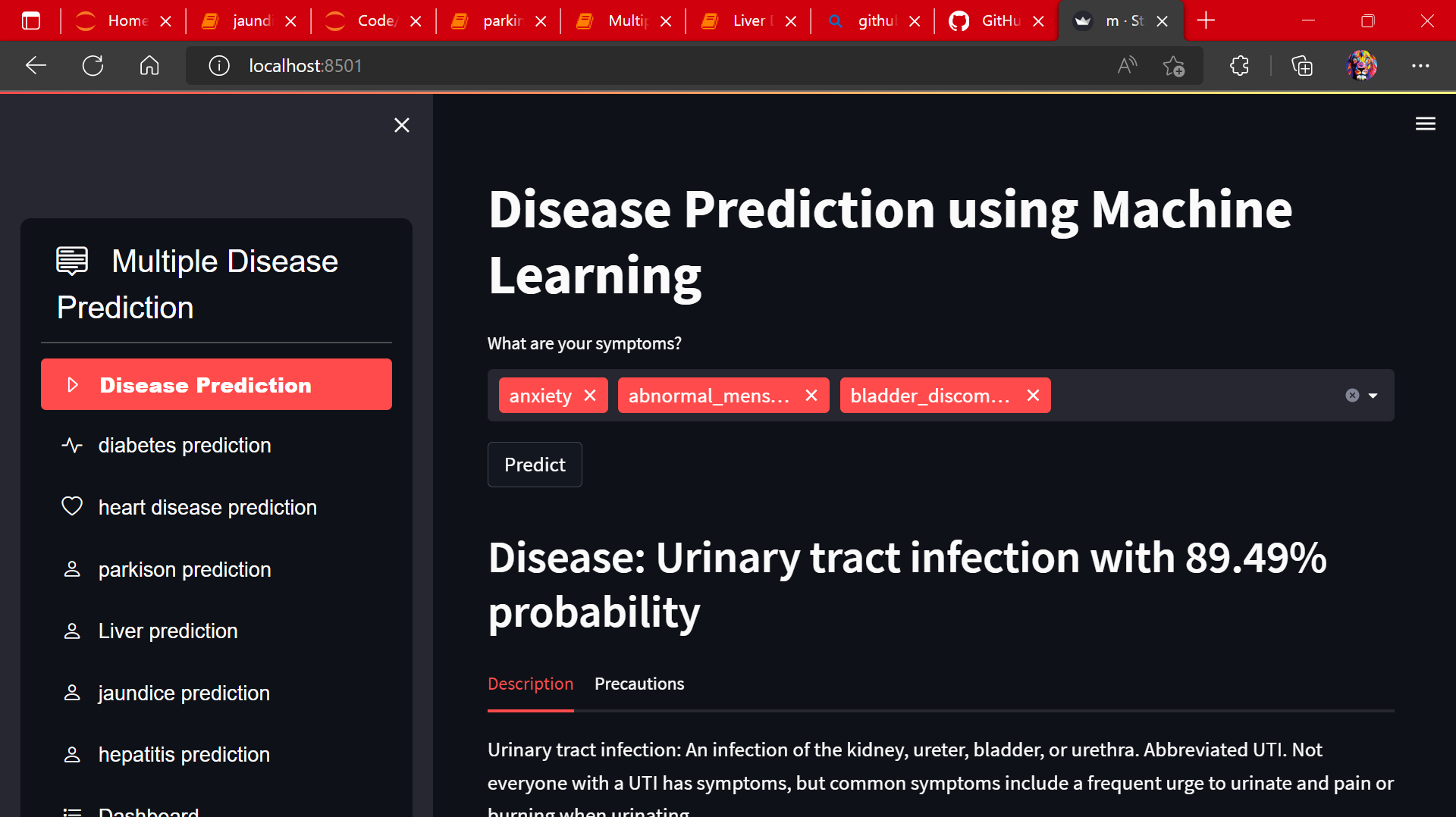
Disease Prediction Based on Symptoms Using Machine Learning

Slide 10
HEART FAILURE PREDICTION
Heart Failure (HF) is a prevalent ailment worldwide, cardiovascular disease is still the leading cause of death. Because so many elements contribute to a patient's survival in heart failure, predicting the chances of survival without using a computational technique can be difficult for cardiac doctors, eventually preventing the patient from receiving correct care.
Fortunately, categorization and prediction models exist, which can assist cardiologists in designing proper treatment schemes using relevant medical data.
This study aims to develop prediction models for patient survival in HF conditions.

Slide 11
DIABETES PREDICTION
Diabetes is a chronic disease with the potential to cause a worldwide health care crisis. According to International Diabetes Federation 382 million people are living with diabetes across the whole world. By 2035, this will be doubled as 592 million.
Diabetes mellitus is a disease in which blood sugars level is abnormally high due to inability of the body to produce or respond normally to insulin. It is among the critical disease and lots of people are suffering from this disease.
In this project we have proposed a diabetes prediction model using Machine Learning algorithm for better prediction. We have tried different Machine Learning algorithms to find which gives the better accuracy of classification

Slide 12
PARKINSONS DISEASE PREDICTION
The Parkinson’s disease is progressive neuro degenerative disorder that affects a lot only people significantly affecting their quality of life.
It mostly affect the motor functions of human. The main motor symptoms are called "parkinsonism" or "parkinsonian syndrome".
The symptoms of Parkinson’s disease will occur slowly, the symptoms include shaking, rigidity, slowness of movement and difficulty with walking, Thinking and behavior change, Depression and anxiety are also common. Parkinson’s disease is difficult to diagnose.
In this model, the huge data is collected from previously affected person and then by using machine learning algorithm will process the user input data with previous data to check he/she affected.

Slide 13
LIVER DISEASE PREDICTION
With a growing trend of sedentary and lack of physical activities, diseases related to liver have become a common encounter nowadays.
In rural areas the intensity is still manageable, but in urban areas, and especially metropolitan areas the liver disease is a very common sighting nowadays.
Liver diseases cause millions of deaths every year. Viral hepatitis alone causes 1.34 million deaths every year.
An early diagnosis of liver problems will increase patient’s survival rate. Liver failures are at high rate of risk among Indians.

Slide 14
JAUNDICE DISEASE PREDICTION
Jaundice occurs when rise in level of bilirubin causes the
skin, mucus membrane and white part of eyes to appear yellowish.
bilirubin is a reddish yellow substance produced
when red blood cells break down.
it is excreted through liver. The bilirubin level will rise up when abnormally high level of red blood cells breaking down.
Any person with liver disease develops jaundice (i.e.) when liver does metabolize bilirubin the way it’s supposed to do, jaundice is developed.
Depending on the underlying cause of jaundice, treatment will be provided.

Slide 15
HEPATITIS C DISEASE PREDICTION
The proper prognosis of treatment response is crucial in any medical therapy to reduce the effects of the disease and of the medication as well.
The mortality rate due to hepatitis c virus (HCV) is high in India as well as all over the world. The virus of this disease can spread from one infected person to another healthy human being.
This disease has already infected almost 17 million people in all over the world and the numbers are getting increased day by day [2-6].
The virus of hepatitis c needs to be treated as early as possible to control and reduce the effects of the disease.

Slide 16
PROJECT REQUIREMENTS
Software USED : Python interpreter , jupyter notebook, Vs code , Any browser
Front-end USED : streamlit python library
Back-end USED : Python , NumPy ,Pandas,
Scikit-Learn,
Database USED : sqlite3

Slide 17
FUTURE SCOPE
In the future we can add more diseases in the existing API.
We can try to improve the accuracy of prediction in order to decrease the mortality rate
Try to make the system user-friendly and provide a chatbot for normal queries

Slide 18
OUR TEAM
T.RAMA KRISHNA
301411221025
SHEIKH MOHAMMAD ATAHAR
301411221047
RAHIL UBAID KHAN
301411221038

Slide 19

Do you have any question?
tramakrishna3012@gmail.com
+91 6266246151
yourcompay.com

